Slide 1
Engineering design 2025
Lecture Week 3
Deck 2
Requirements and
Specifications
Prof Henri Marais
29 Jul 2026

Slide 2
Requirements vs Characteristics
Problem Domain
Solution Domain
What is needed?
(Requirements)
Requirements Analysis
What is offered?
(Characteristics)
Some items you will evaluate, buy, integrate, and test
✓
Buy (Procurement)
Close the loop…
Other items you will design, build integrate, and test
Make (Engineering)
Combinations of bought and developed items will make up the final product / system

Slide 3
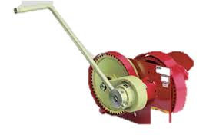
Some Context
Requirements
Figure out what the system or product needs to do
Specification
Capture all of the requirements
Design Process
Crank the handle on 3rd Year Design

Slide 4
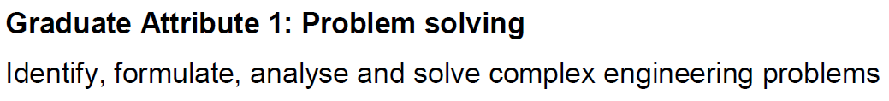
Engineering design, requirements, and ga 1
SPECIFICATION DOC
REQUIREMENTS ELLICITATION

Slide 5

Specification vs Requirements
Requirement
- Statement of ONE thing
- System performance or characteristic
- Must be complete and exact to be useful
Specification (Requirement Specification)
- Collection of all requirements
- Including verification requirements

Slide 6
Requirements: Levels
There are commonly several levels to any system
Business
Operational
Technical
Detail
A business requirement is usually the beginning
In this module we work from the operational level towards the detail
Detail requirements are typically passed to specialist engineering

Slide 7
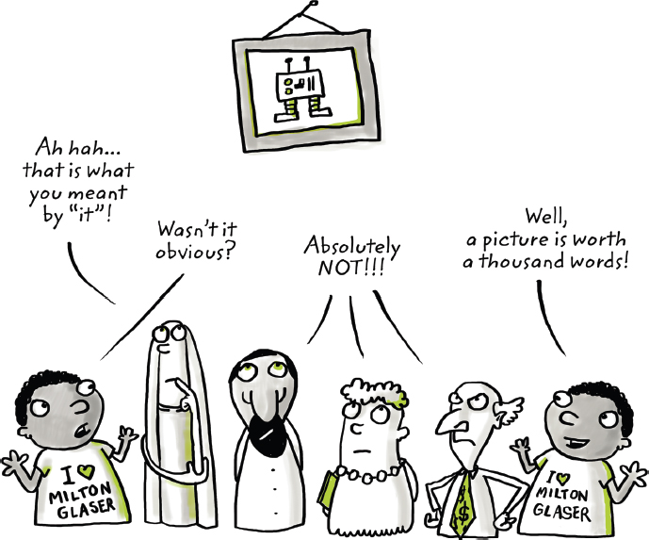
Details of a requirement
Requirements must be:
Clear and Specific
Unambiguous
Measurable
Verifiable
Requirements are either
Functional (technology/implementation agnostic) or,
Non-functional
Design related

Slide 8
Requirements : Types (Functional)
Function
Client / user requirements (User Requirement Statement - URS)
Functional requirements (what the system / product must do)
Performance requirements (how well, how much, how often etc)
Physical requirements (weight, size, materials etc)
Interface requirements (physical interfaces, human-machine etc)
Design requirements (“build to”, “code to”, “buy to”, “-ilities”)
Deployment (where used, modes of use, context of product in physical system)
Other requirements (see slides below) falling under “non-functional”
Derived requirement (implied or transformed from higher level)
Allocated requirement (created by dividing other requirement)
Form
Fit
Notes:
You’ll notice that we generally refer to form fit and function when referring to systems as this keeps thigs clear but more formal language also exists.

Slide 9
Requirements: Types (non-Functional)
“Design for” – all the “-ilities”:
Usability
Modularity
Maintainability
Reliability
Interoperability
Transportability
Environmental requirements – ingress, corrosive, etc.
Legal requirements – regulatory, standards
Social requirements – safety, ergonomics, cultural considerations
Commonly an engineering specialty in own right, e.g. “Reliability engineering”

Slide 10
Design requirement
Technically speaking can be functional or non-functional
Specifies elements of the technical design
A Siemens S7-1200 PLC shall be used
No Arduino derived or based software libraries shall be used
Since this limits the solution space (early on without all the information available) should be used very conservatively and with good reason

Slide 11
Measures of Effectiveness (MOEs)
- Relates to mission performance
- Simple to state
- Testable
- Can be measured quantitatively
- Easy to measure
- Can be expressed probabilistically
Measure of Performance (MOP)
- Directly quantifiable
- Speed, payload, Voltage, range, etc.
Measure of Suitability (MOS)
- Ability to be supported
- Reliability, Maintainability, etc.
HOW WELL?

Slide 12
Where to start? – Get some requirements…
Requirements elicitation
Getting the requirements from the customer
Ideal world – customer provides all requirements in usable form
Real world – customer provides some requirements, implicit requirements, vague requirements, contradictory requirements
Conceptual Design / Context Analysis

Slide 13
Attributes of good requirements
Achievable
Verifiable
Unambiguous
Complete
Consistent
Express need
Appropriate for level

Slide 14
Attributes of good requirements
Achievable
Reflect a need or objective for which a solution is technically achievable at a cost considered affordable.
Verifiable
Not defined by words such as sufficient, resistant, light, heavy, excessive.
Expected performance must be objective, preferably quantitative
Unambiguous
Complete
Consistent
Express need
Appropriate for level

Slide 15
Attributes of good requirements
Achievable
Verifiable
Unambiguous
Complete
Include all environmental considerations, operational concepts, and constraints
Consistent
Must be consistent with other requirements
Conflicts must be resolved up front
Express need
Appropriate for level

Slide 16
Attributes of good requirements
Achievable
Verifiable
Unambiguous
Complete
Consistent
Express need
“Why” and “What” of the need. NOT how to do it
Appropriate for level
Not too detailed for current level
Component level requirements are best left to lower levels of decomposition

Slide 17
Bad stuff – avoid like the plague
Ambiguity The system shall be able to provide historical reports
Vague terminology The e-mail application must have an intuitive user interface.
Illusions and fantasies The printer shall be always operational
Multiple requirements The guest shall pay the bill with money or credit card
Design*** The clock shall present the current civil local time, by receiving code time
signals from a radio station
Speculations It is possible that the vending machine might offer mineral water
Suggestions The product should probably be able to receive signals from the outside,
even when used in a train moving at least at 130 km/h.
Project plans
Notes:
*** with reference to slide on design requirements.

Slide 18
Good requirements
- Require structure
- Must be complete
- Must be verifiable
- Cannot be optional
The parsing template helps to:
- Identify missing elements in existing requirements
- Write better requirements
Parsing Template
Actor
Condition
Action
Object of action
Constraints of action
Refinement of object
Source of object
Destination of action
Refinement of action
Notes:
It is quite typical that the requirements received from the client / customer / higher-level will be in text-based form. This leads to all sorts of problems associated with natural language, but also gives us the ability to perform parsing on those textual requirements.
One advantage is that a parsing template can be used in reverse to write good requirements to begin with!
NOTE: This is not the only parsing template but is a very comprehensive one. Not all requirements will necessarily comply with all elements of the parsing template. If only a few elements are present it is typically indicative of low-quality requirements.

Slide 19
A (very) bad requirement
“Messages should be switched.”
Unclear which messages
What should do the switching
Performance limits of the switching
“should” denotes optionality. So is this functionality optional?
Don’t interpret! AS IT IS WRITTEN

Slide 20
Example of template application
Parsing Template
Actor
Condition
Action
Object of action
Constraints of action
Refinement of object
Source of object
Destination of action
Refinement of action
The system
What will do the work?
Upon receipt of the message
When will the “ACTOR” do the work?
Shall switch
What is the “ACTION” that the “ACTOR” will take?
The message
On what object will action be taken?
Performance constraints on the action being taken…
Within 10 ms of receipt
For messages in the ABC123 format
Can we make the object more specific?
From the message input port
Where does the object come from?
To a message output port
Where does this action terminate?
Corresponding to the routing indicator
Can we refine the action some more?

Slide 21
A (much) improved requirement
The system
upon receipt of the message
shall switch
the message
within 10 ms of receipt
from the message input port
to a message output port
corresponding to the routing indicator
for messages in the ABC123 format

Slide 22
Example – User requirement
User requirements
Subject that indicates the type of user(s)
Intended functionality to achieve
The object involved
Mechanism to allow a test to be achieved
(user) The Hotel receptionist
(functionality) shall visualise
(object) the room number of a guest
(test) within 2 s after making the request

Slide 23
Example – System Requirement
System requirements
System or entity related to this requirement
Intended functionality
Description
(system/entity) The charge signal of the power supply
(functionality) shall turn on
(object) if the batteries are below 10% of full

Slide 24
Examples – Non-functional requirements
Non-Functional requirements
System or entity related to this requirement
A quality to be achieved
Description to complete the sentence
The product shall be easy to use for illiterate people
The product must function at 10 m under water
The source code of the product must contain comments
The source code must be subjected to version control

Slide 25
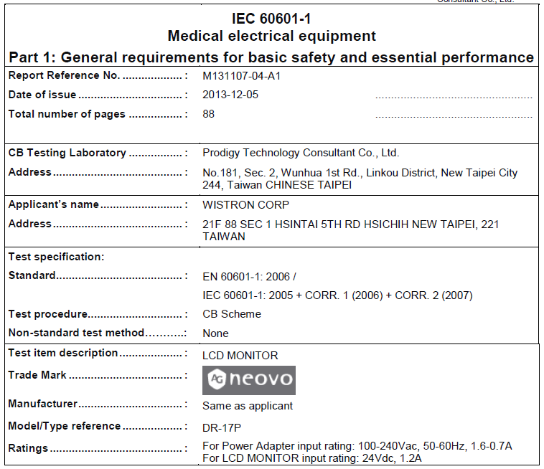
Verification of requirements
Deals with determining if your system meets the requirements
Must be explicit in terms of HOW
For EACH requirement
How will compliance be measured
With what will it be measured
If possible, use existing standards

Slide 26
Verification requirements and GA 1
Verification requirements can help to prove that at least part of the complex problem was solved
Implies that a performance requirement is at play
Necessitates careful wording of the verification requirement

Slide 27
Verification requirement: Example OF GA 1 UTILITY (SOLVE aspect)
Stand-alone PV system is required
MPPT shall be implemented
Power a load of say 500W (student computer)
Requires that EVERYTHING has been completed.
Power converter functionality shall be demonstrated in a controlled environment. [VREQID_001]
Power converter performance shall be determined by application of a known I-V source (laboratory grade DC power supply ABC-123). [VREQID_002]
The power converter performance characteristics, the mathematical MPPT point, and the input I-V values shall be graphed on a single axis to demonstrate MPPT functionality of the power converter. [VREQID_003]
Very stringent requirement with little
room for deviation / non-compliance
This only deals with functionality, the performance
of the system may be limited (say only 150W achievable).

Slide 28
Requirements analysis: Questions
Reasons behind system development
Customer expectations
Who are the users, how do they intend to use the system?
What do users expect from the product?
What is the level of expertise of the users?
Under which environmental conditions should the system operate?
What are existing and planned interfaces?
What functions will the system perform?
What are the constraints?

Slide 29
Operational Requirements: Basic questions
Deployment / Distribution where will the system be used
Performance and related parameters critical parameters
Concept of use how is the system to be used
Effectiveness requirements how effective or efficient must missions be performed
Operational life-cycle how long will the system be in use?
Environment where will the system be used

Slide 30
Wrapping up
Requirements are encapsulated in a specification
01
Requirements have specific characteristics and should express need not drive solutions
02
Design requirements limit solution space and should be minimized.
03

Slide 31

Individual activity
For the hoisting system (as an individual) develop at least 7 requirements (5 functional, 2 non-functional) using the parsing template. Upload completed works to efundi.

